Slide 1



Ignite your app development: Firebase+NativeScript+Angular 2
Jen Looper Developer Advocate, Telerik / Progress
@jenlooper

Slide 2


Slide 3

$whoami
Ph.D. … in Medieval French
Retrained!
Programmer 14 yrs+
ladeezfirstmedia.com, thinglearn.com
Now DevRel@Telerik

Slide 4
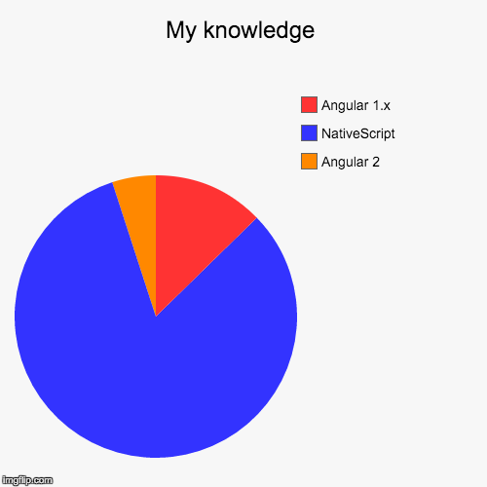
I’m a developer & I like mobile apps!
Notes:
Who am I?

Slide 5
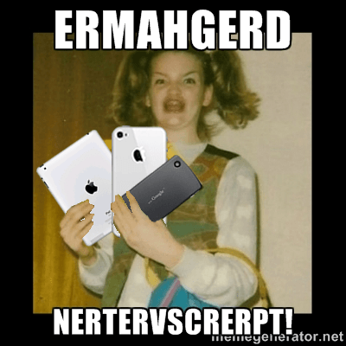
I like NativeScript
Notes:
Who am I?

Slide 6
NativeScript
For Mobile Apps
Notes:
What is nativescript

Slide 7


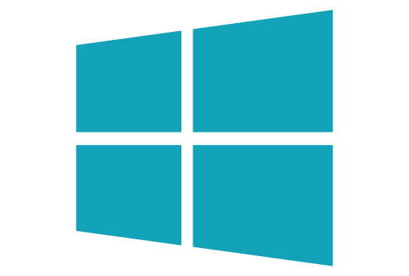
What is NativeScript?
A runtime for building and running native iOS, Android, and (soon) Windows Universal apps
with a single, JavaScript code base with or without using Angular JS.

Slide 8


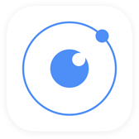
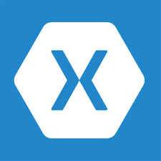


!=
No DOM
!=
No cross compilation
!=
Direct access to native APIs via JS
Notes:
{N} in a N app, there is no DOM! We don’t rely on the browser to serve up a mobile-ish web page. Our elements are native mobile elements.
{N} vs Xamarin - no cross compilation at all
{N} vs React Native and Appcelerator (Titanium) – we offer direct access to native APIs in JS

Slide 9
Why NativeScript?
Skills reuse
JavaScript and CSS
Angular2
Code reuse
npm modules, 3rd-party iOS and Android libraries
Easily use native APIs
No wrappers to access native APIs
Use native UI elements
Open source
Supported in Telerik Platform

Slide 10





Bridge

Slide 11
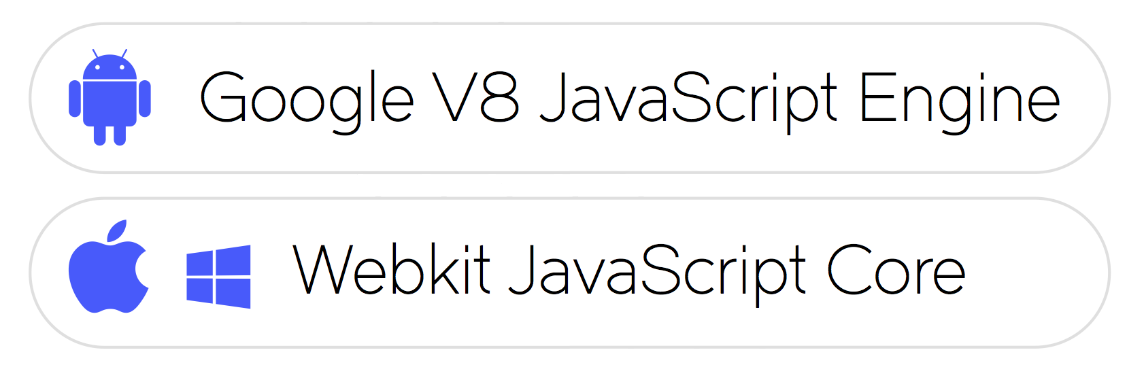
JavaScript Virtual Machine
Notes:
NativeScript is not just a set of libraries, but rather a Runtime that enables you to call native APIs: for Android, iOS and Windows Universal. Think of it as a translating engine.
It uses a pre-packaged JavaScript Virtual Machine to bridge between JavaScript code and Native APIs. To be precise:
•For Android it is – Google’s v8 JavaScript Engine,
•For iOS and Windows Phone it is – WebKit’s JavaScriptCore

Slide 12

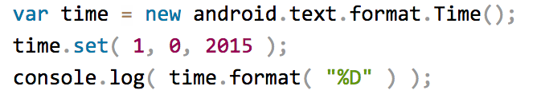
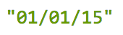
NativeScript Android example
output:
JavaScript
Notes:
I'll give your brain a minute or two to parse this, because yes, this JavaScript code instantiates a Java android.text.format.Time() object, calls its set() method, then logs the return value of its format() method, which is the string "01/01/15".

Slide 13
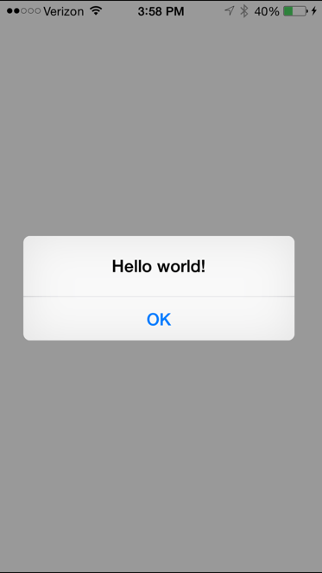

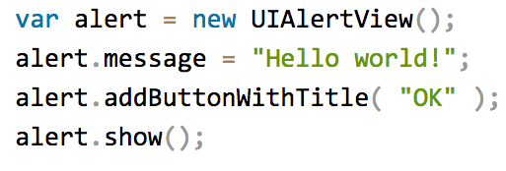
NativeScript iOS example
JavaScript
Notes:
This JavaScript code instantiates an Objective-C UIAlertView class, sets its message property, and then calls its addButtonWithTitle() and show() methods. When you run a NativeScript iOS app with this code you'll see the alert on the right:

Slide 14
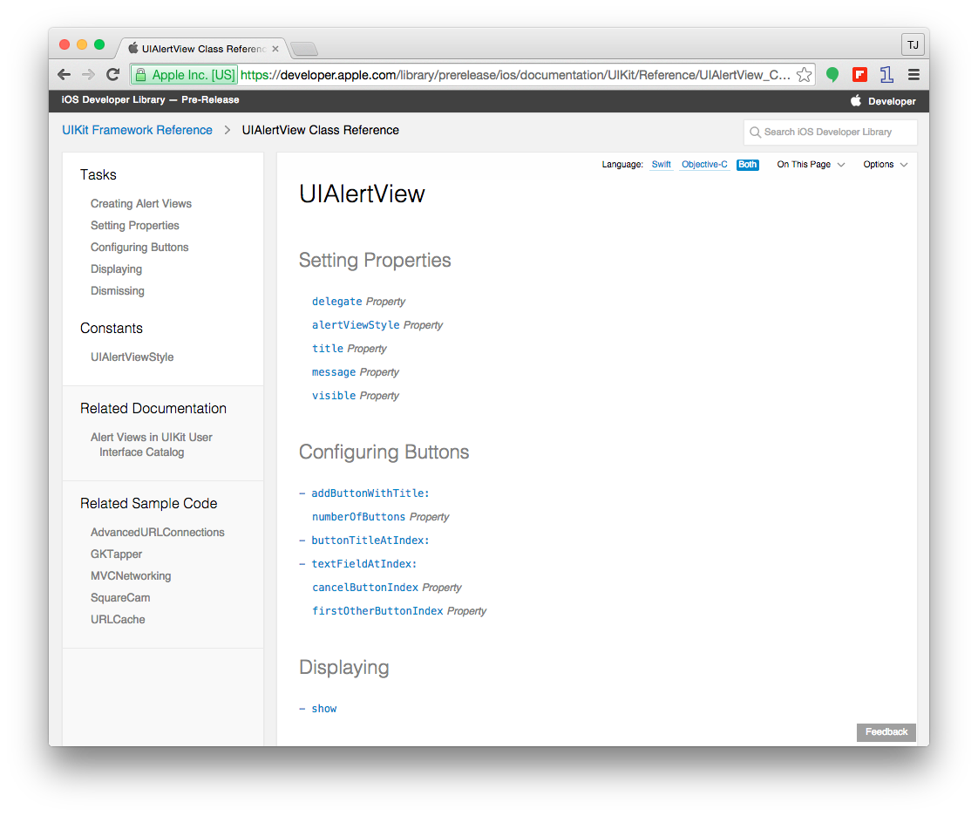
Notes:
You can dig into the iOS native code to extrapolate the JS you need to write (if you really want to!)

Slide 15
Runs on V8 JavaScript VM
Runs on JavaScriptCore VM
Notes:
here are some more examples which run native code on the appropriate Virtual Machine for the appropriate platform.

Slide 16
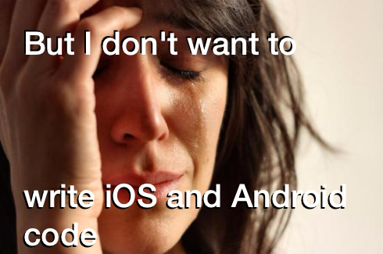

Slide 17
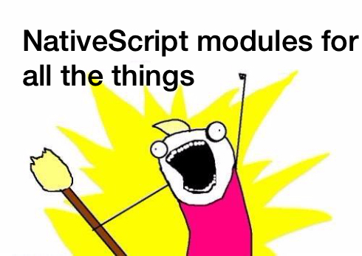

Slide 18



NativeScript modules
Code
Modules
Platform API
2016
Notes:
NativeScript comes equipped with modules that provide cross-platform functionality.
There are dozens of them and they’re easy to write yourself.
NativeScript modules follow Node module’s conventions (CommonJS).

Slide 19
Notes:
Another way to look at it.

Slide 20
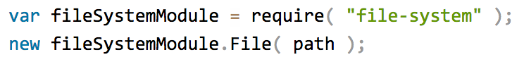

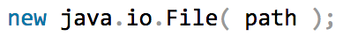

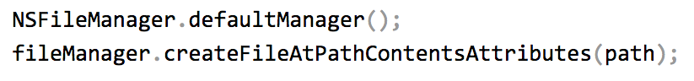
Example: NativeScript file module
Notes:
Here’s an example of a NS file modules. One module, 2 native code snippets encapsulated

Slide 21
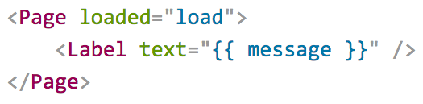
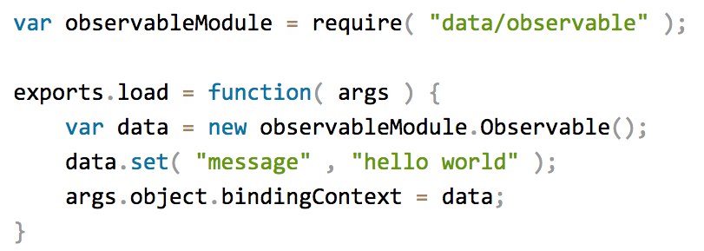
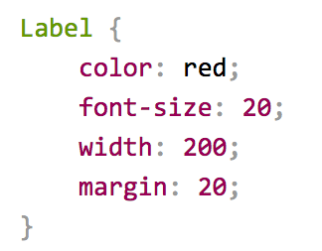
Putting it all together
Define UI with XML
Logic with JavaScript
Style with CSS
Notes:
A Vanilla NativeScript app consists of modules (like Page, Label), JS logic, and CSS to make it look nice.

Slide 22

Notes:
Put it all together, and you get…...

Slide 23
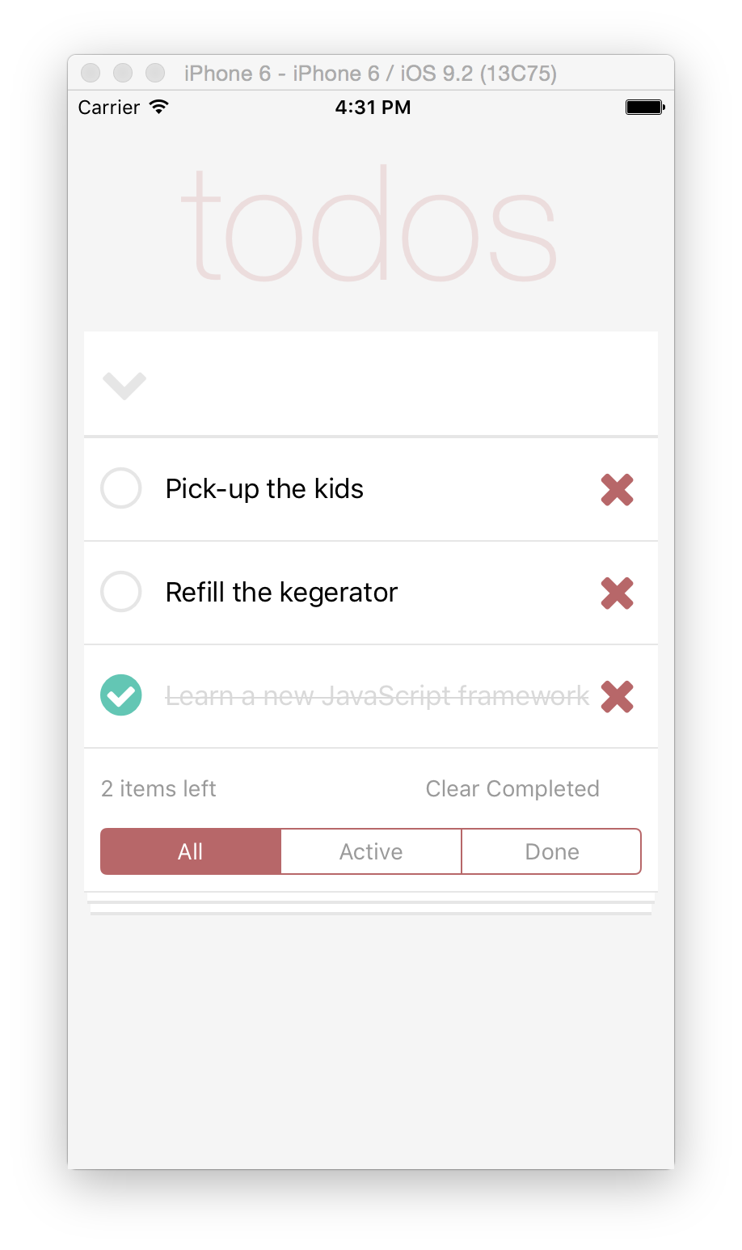
Notes:
It will create for you, with one codebase, a cross-platform mobile app

Slide 24
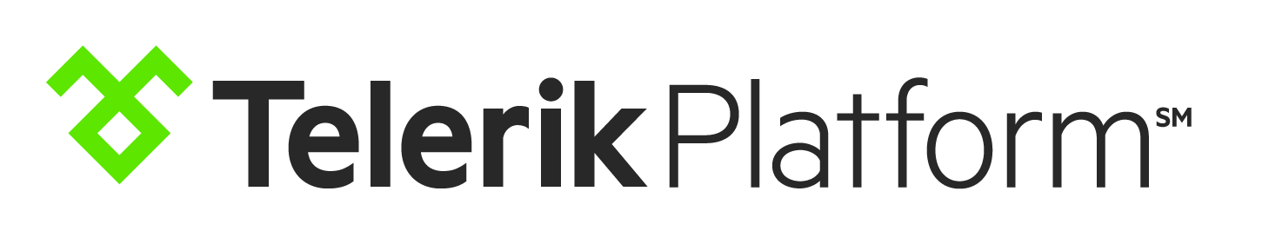
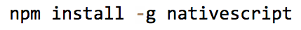
Two ways to use NativeScript
1)
2)
Notes:
Platform
CLI

Slide 25
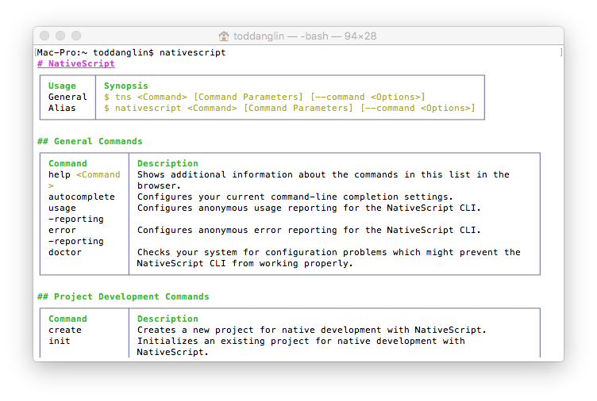
Command Line Interface (CLI)
Use Command Prompt (Win) or Terminal (Mac, Linux)
Free, Part of open source project
Requires installation, local environment setup to build for iOS/Android (requires Mac for iOS)
Integrates with Visual Studio Code (via plugin)
WHY: More control, Free, Integrate with existing IDEs/code editors
WHO: More technical developers used to using CLI, Open source developers
Notes:
With the CLI…

Slide 26
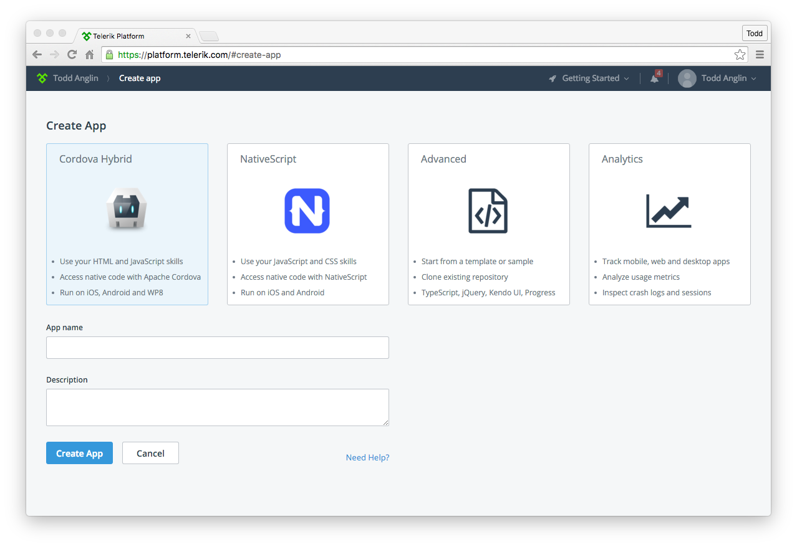
Telerik Platform
Use AppBuilder or Screen Builder
Subscription required
Build in the cloud (no local install required)
Easiest way to get started
Full support for {N}
WHY: Richer tooling, Easier setup, Platform integrated
WHO: Less technical developers, Prefer Platform integrations, Windows developers targeting iOS
Notes:
Or use the Telerik Platform

Slide 27
Two ways to write NativeScript
1)
Standard JS + CSS + XML
2)
Angular 2
Notes:
You not only have two ways to develop {N} mobile apps in terms of your development environment, you also have two ways to write {N} yourself – ‘vanilla’ NS or the NG2 flavor.
Let’s talk about ng2

Slide 28
Angular 2
Architecture / Framework
Notes:
What’s the deal with angular 2? Why use it with N?

Slide 29

Notes:
For the past year we’ve been working directly with the Angular team to bring Angular 2 and NativeScript together…
We are doing this to provide the same experience of building mobile apps as it is for web apps.
And thus allowing Angular developers to reuse their skills.
It’s all about skills reuse and code reuse.

Slide 30



Mix Well
Notes:
So what we’re do is take our Angular 2 codebase, mix it well with NativeScript, and…

Slide 31

Notes:
…we’ll get Angular for {N}, or Nangular, or something.

Slide 32



Tobias Bosch
Hristo Deshev
Notes:
We have been collaborating heavily with Google to make this happen
Regularly, since last May 9 :
A lead developer from the Angular Team [picture of Tobias Bosch]
and Telerik Team [picture of Hristo Deshev]
met using Google Hangouts to architecture NativeScript’s entry into the new world of ng2.

Slide 33
Why NativeScript + Angular 2?
Angular 1 = a technology that relies on browser tech to manipulate the DOM.
NativeScript has no DOM to manipulate
Angular 2 decoupled the Angular framework from the DOM
The door is open to new mobile-friendly tech to leverage this newly decoupled framework!!
Notes:
Why is Ng2 so attractive?
N apps can’t use browser tech like span etc. to build an interface, you must build using N ui components

Slide 34
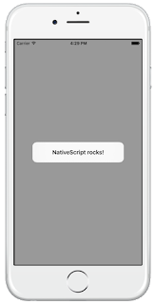
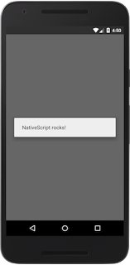
A standard {N} app snippet
<!-- main.xml --> <page>
<StackLayout>
<Button text= "Hello World" tap= "showAlert" />
</StackLayout>
</page> /* main.js */ var dialogs = require("ui/dialogs"); exports.showAlert = function() { dialogs.alert({ message: "NativeScript rocks!" }); };
Notes:
This code will open a native dialog when a native button is tapped

Slide 35
Same functionality, {N} + ng2
// main.ts import {nativeScriptBootstrap} from "nativescript-angular/application"; import {Component, View} from "angular2/angular2"; import {dialogs} from "ui/dialogs"; @Component({}) @View({ directives: [], template: ` <stack-layout> <button (tap)="showAlert()" text="Hello World"></button> </stack-layout> ` }) class HelloPage { showAlert() { dialogs.alert({ message: "NativeScript rocks!" }); } } export function loaded() { nativeScriptBootstrap(HelloPage, []); }
Notes:
NativeScriptBootstrap() vs. bootstrap()
In an Angular 2 web app, you call the bootstrap() function in the "angular2/angular2" module to initialize your components.
In NativeScript apps you need to call nativeScriptBootstrap(), which is a lightweight wrapper of bootstrap() that does some NativeScript-specific initialization.
The UI components in the template
In an Angular 2 web app your “Hello World” button example would probably be rendered as <div><button>Hello World</button></div>.
But in NativeScript apps you need to use XML widgets that NativeScript is able to render in native mobile apps.
This example uses a <stack-layout> element, which is the simplest of NativeScript’s layouts, and places a single <button> element within it.

Slide 36
The big picture
XMLHttpRequest
<NS Module>
Native
iOS call
Native Android call
iOS App
Android App
Notes:
A NativeScript App

Slide 37
The bigger picture ({N}+NG2)
HTTP
<Angular Component>
XMLHttpRequest
<NS Module>
XMLHttpRequest
<Browser>
Native
iOS call
Native Android call
Ajax call
iOS App
Android App
Web App
Notes:
A NativeScript app with Angular love - that's going to have code reuse to the web

Slide 38
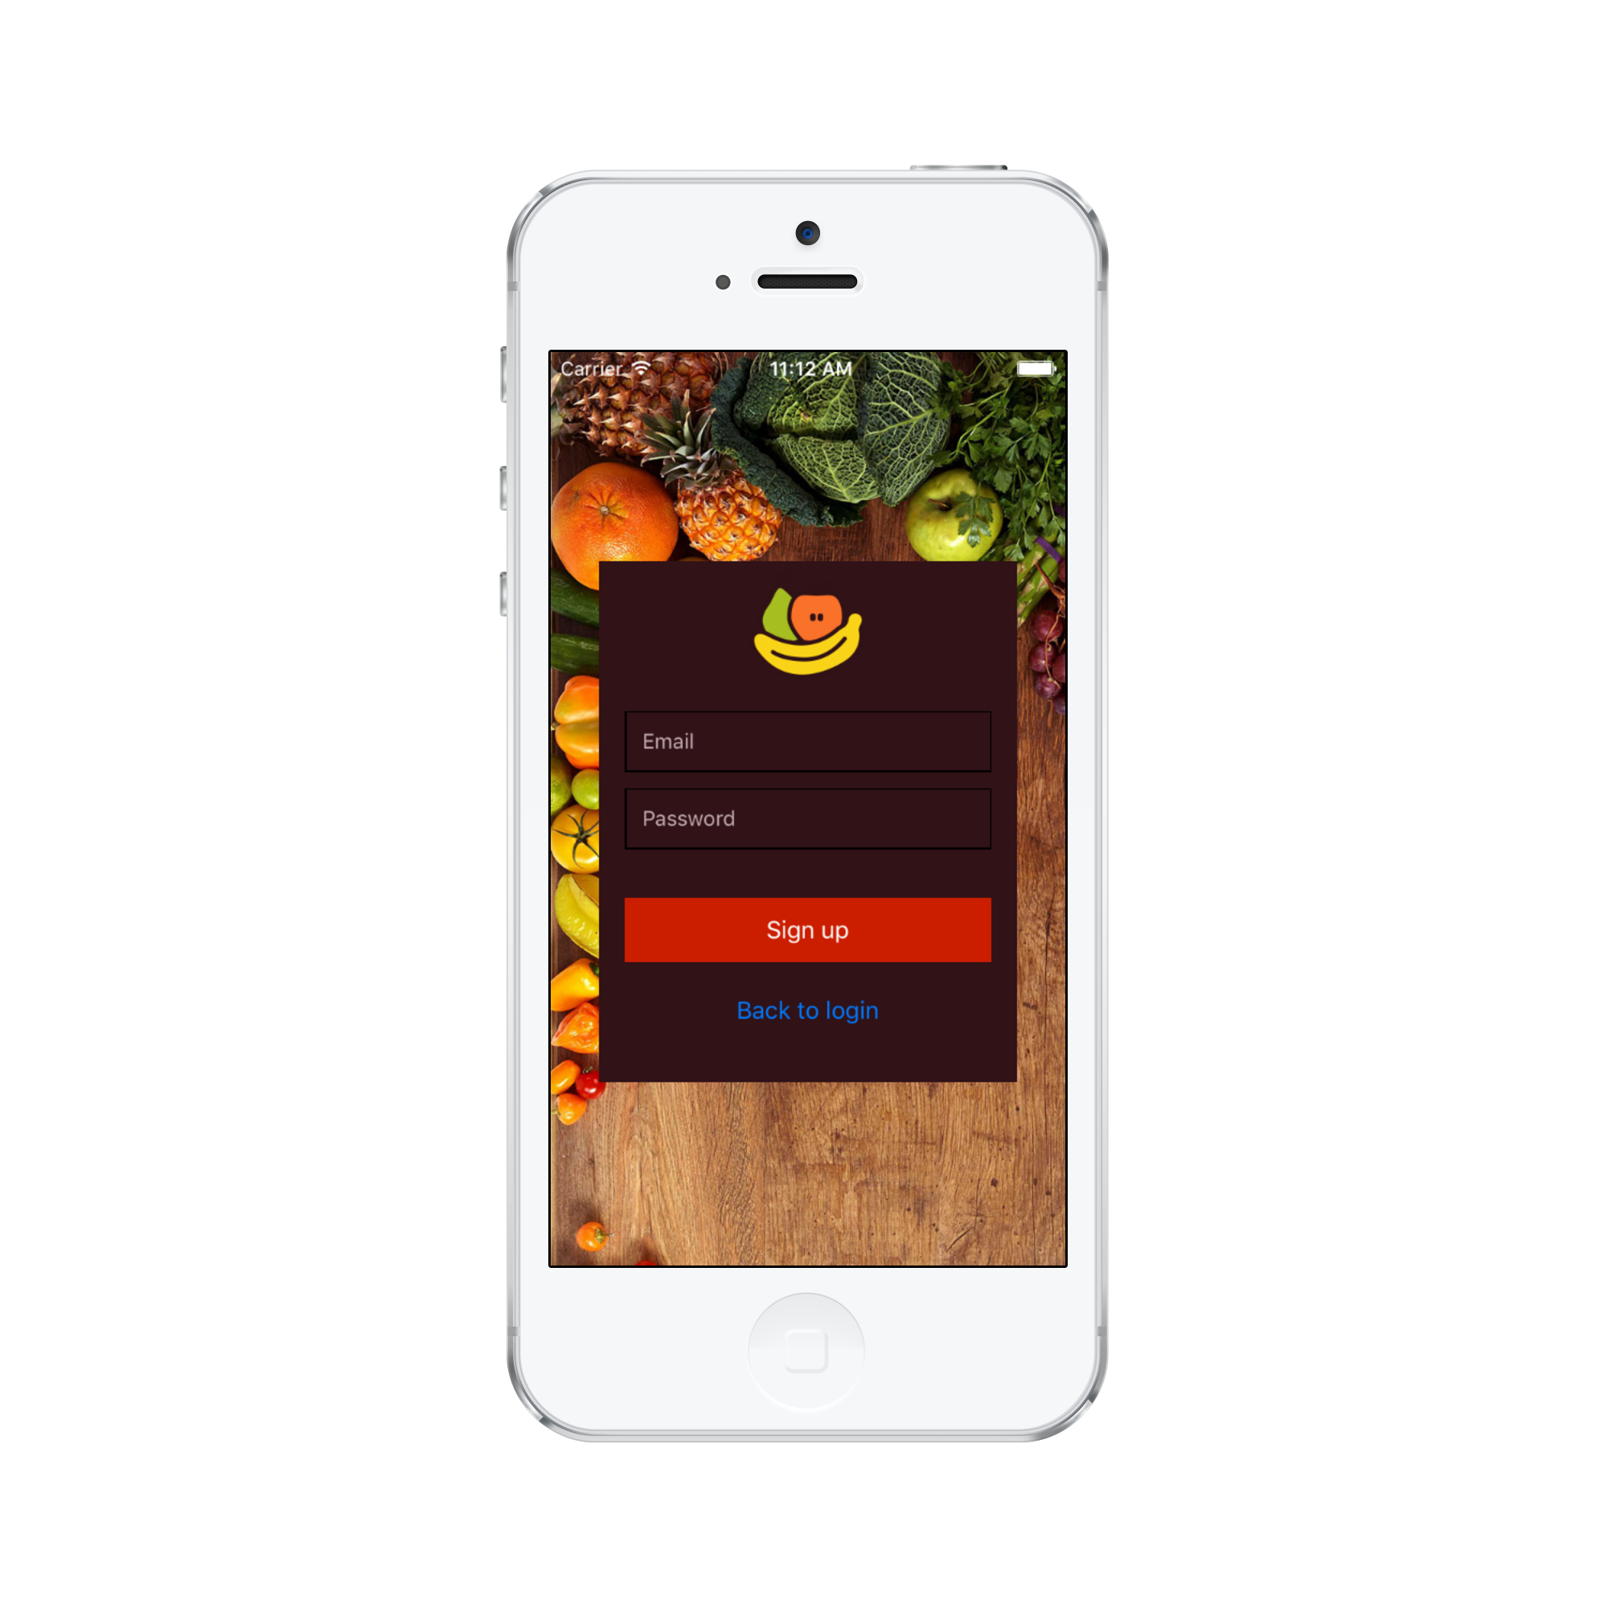
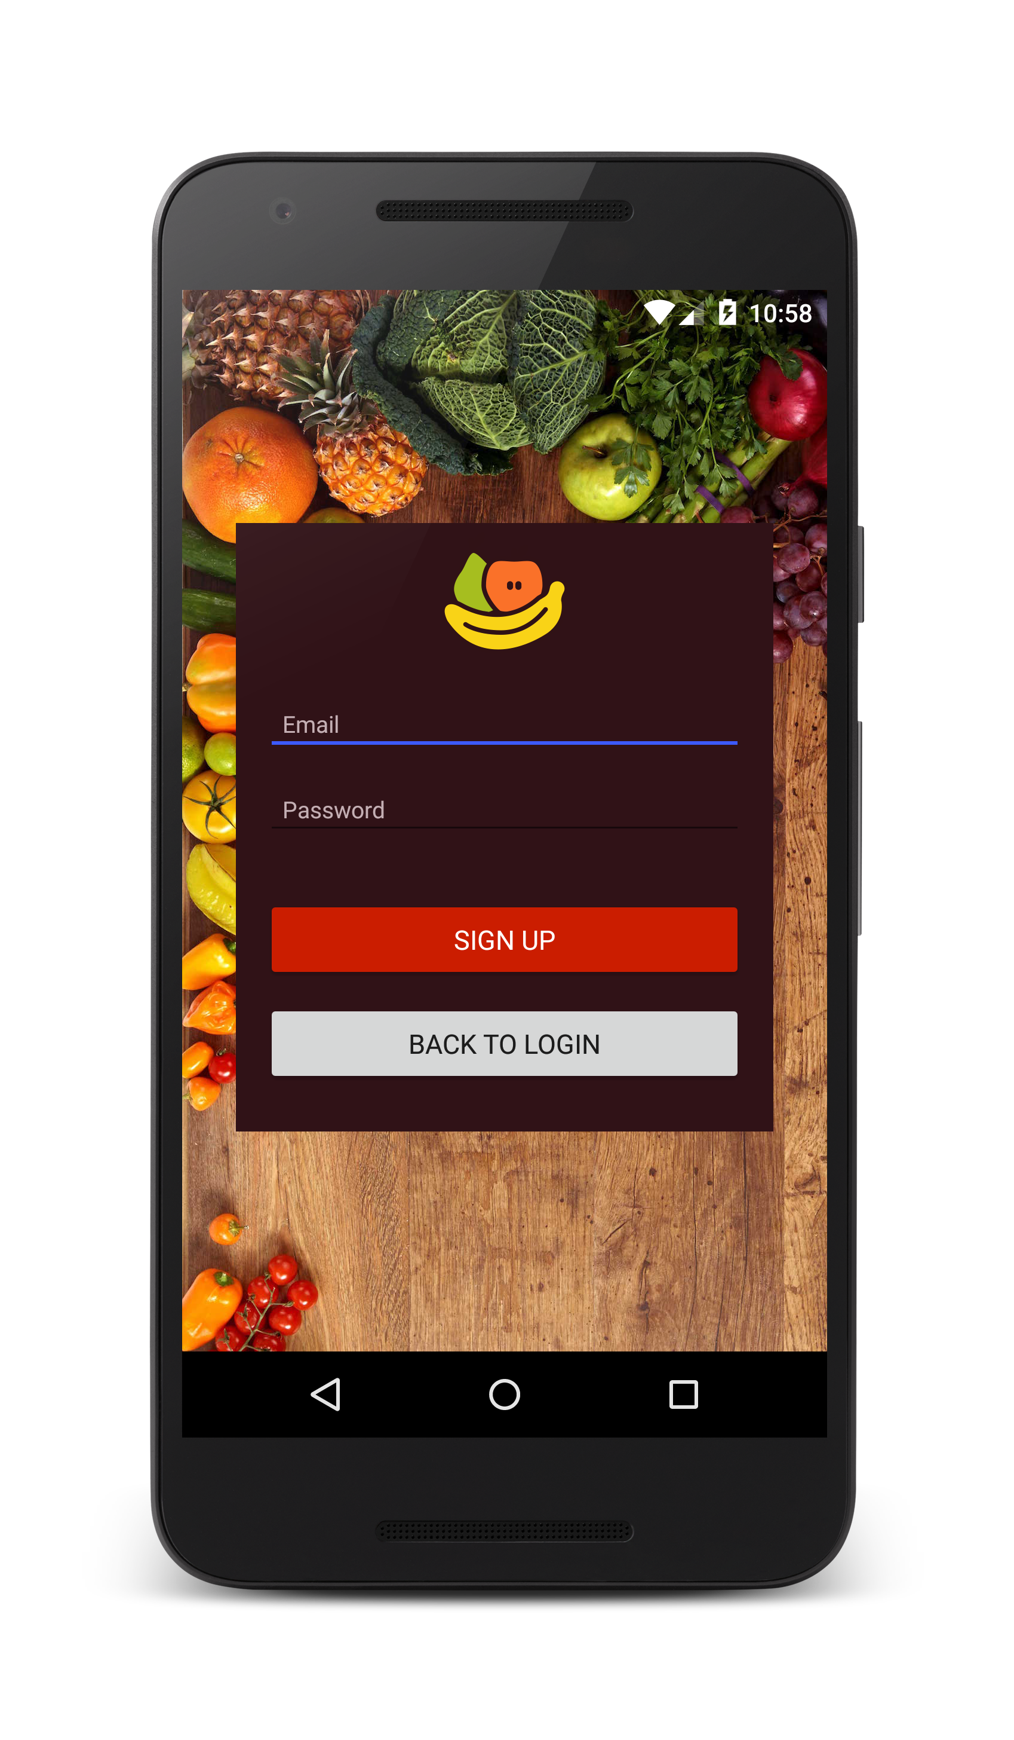

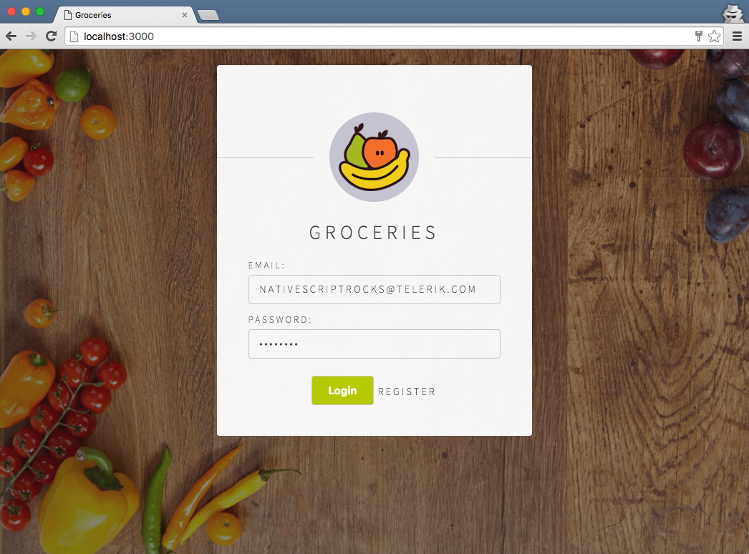
Android
iOS
Web
Notes:
Now the idea that we can write something once, and run it everywhere is one of the reasons people are so attracted to Angular 2 - because you can use the code that you already wrote for the web, and leverage {N} to build for Android and iOS to create a truly native mobile app with no webview in sight!

Slide 39
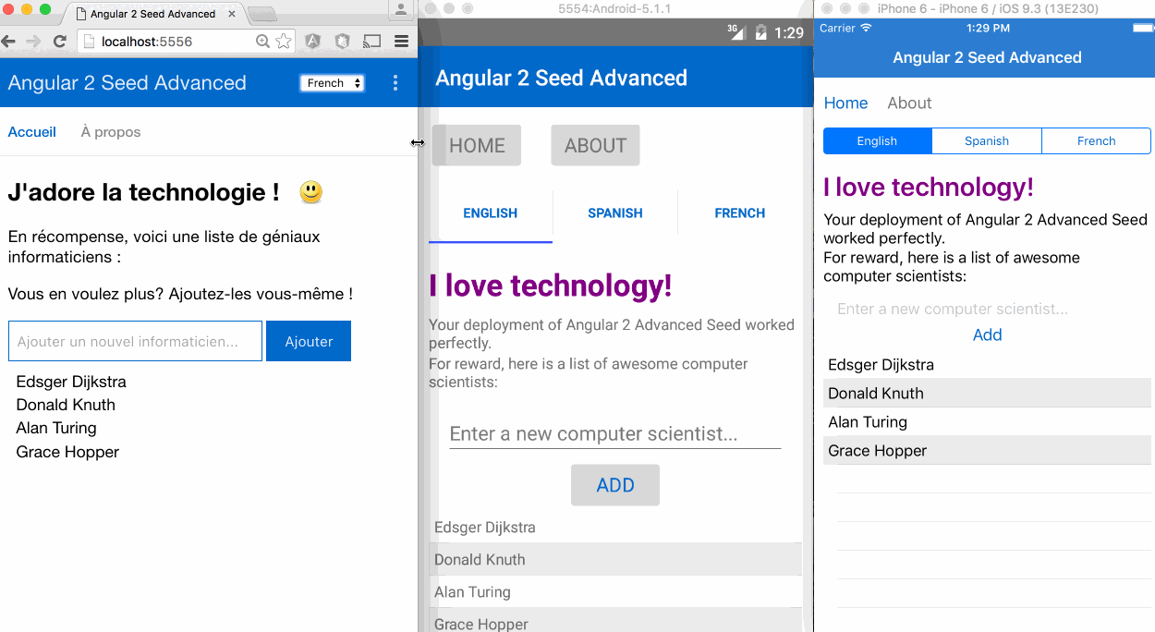
Angular 2 advanced seed
http://bit.ly/nativescript-angular-seed
Notes:
(Jen) community initiatives are being built right now to make this happen – build your web and mobile apps with shared code, all at the same time.

Slide 40
One syntax for all
Attribute Binding: | [attribute]
Event Binding: | (event)
Intercepting input: | #idhandler
Conditions: | *ng-if="expression"
Loops: | *ng-for="expression"
Styling: | [class.myStyle]="expression"
Notes:
Angular 2 makes things standardized. Write your mobile app ‘the angular way’

Slide 41
The difference is in the UI
Web UI != Mobile UI
Notes:
This might be obvious – but here’s where all this code sharing may find its limits

Slide 42
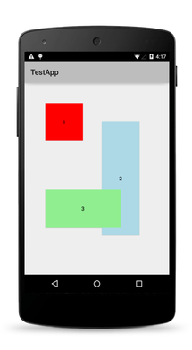
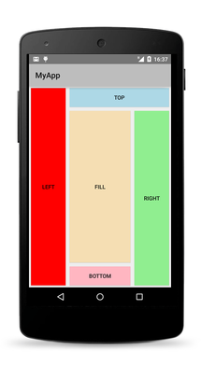
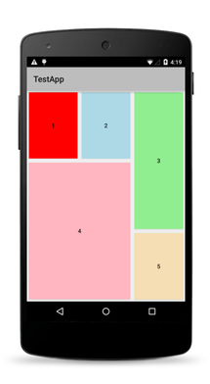
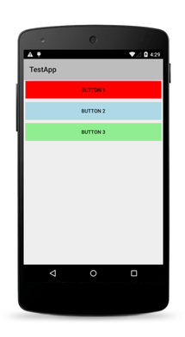
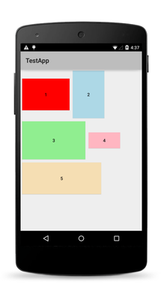
Native Layouts
Absolute
Dock
Grid
Stack
Wrap
Notes:
Mobile layouts have their own special needs

Slide 43
Firebase
Backend
Notes:
Hopefully I have made the case for using NativeScript and Angular 2. Now let’s talk about where your app can really ignite. Add in firebase as your backend, and you’ll really go to town.
What is FB? Firebase is a scalable realtime backend that lets you build apps fast without managing servers.

Slide 44

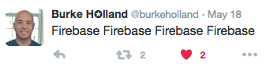
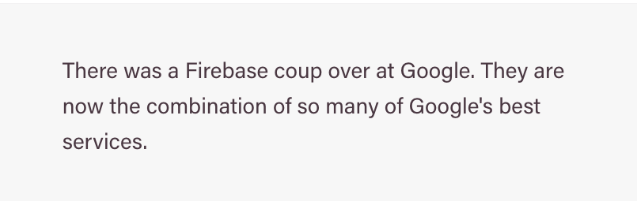
ZOMG Firebase!
Firebase at Google.io
Notes:
Big announcements at google.io about firebase

Slide 45
What’s new with Firebase?
Announcements from Google.io: Firebase 3.0
Firebase analytics
Google Cloud Messaging is becoming Firebase Cloud Messaging (push notification service)
AdMob integration
Remote Storage
Hot push! Firebase Remote Config
(as always) Firebase realtime database
Firebase hosting
Firebase authentication (social logins)
Notes:
Firebase is the newly refurbed hotness.

Slide 46
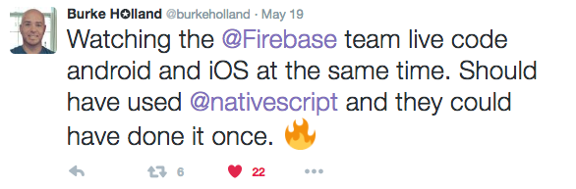
Firebase for mobile apps
Firebase at Google.io
Notes:
A perfect match for N apps

Slide 47
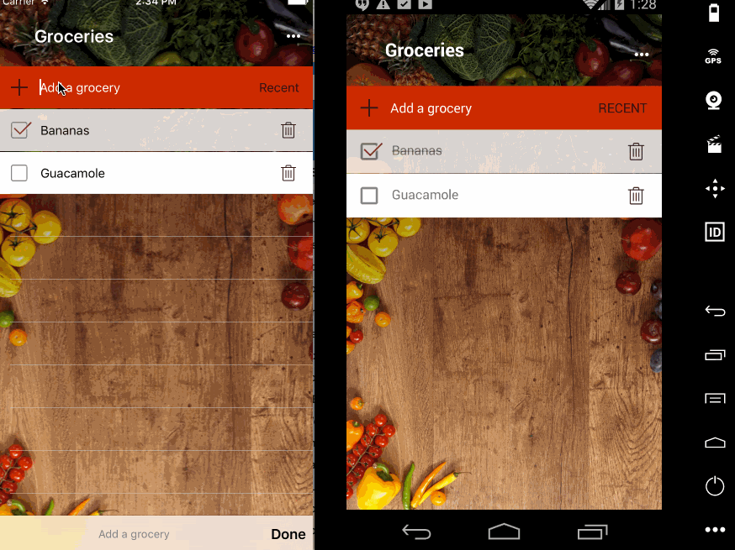
Firebase + Nativescript
Quick demo…
Notes:
I spun up a demo on this a few weeks ago…

Slide 48
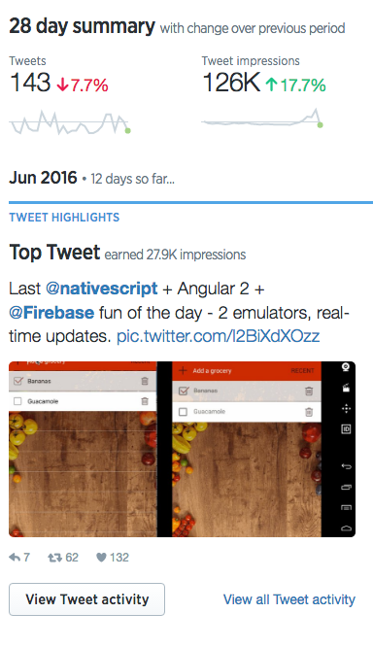

Firebase + NativeScript
Twitter freaks out
Notes:
Twitter freaked out!

Slide 49
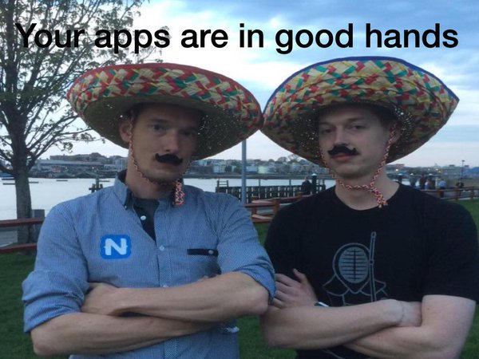
Let’s build!
You need a plugin from this guy
Notes:
So how do you build an app with {N}, Firebase, and Angular 2? Let’s do a code walk through.
First thing you need is a plugin from Eddy Verbruggen, “Mr. Plugin”.

Slide 50
Can we talk?
@jenlooper
http://www.ladeezfirstmedia.com
Telerik DevRel @progressSW
jen.looper@progress.com

